Slide 1
ASSIGNMENT 04 Name: Amas Waseem Class: BSCS (Morning) Roll no: 35 Seat no: B20102077 Section: A

Slide 2
Practical:3
Measures of Central Tendency

Slide 3
Data Entry in MATLAB
Example 1:
Find the arithmetic mean and median of the number 6, 7, 10, 11 and 8
Arithmetic Mean:
Command: Mean (x)

Slide 4
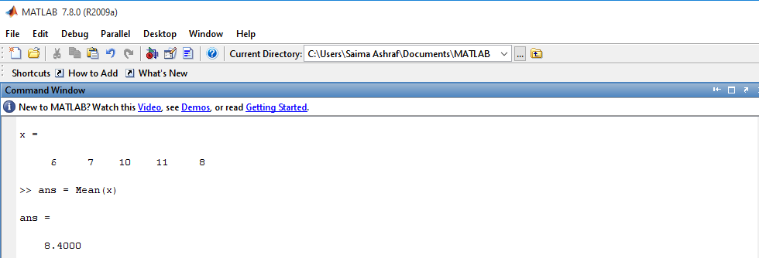
Arithmetic Mean for Ungrouped Data

Slide 5
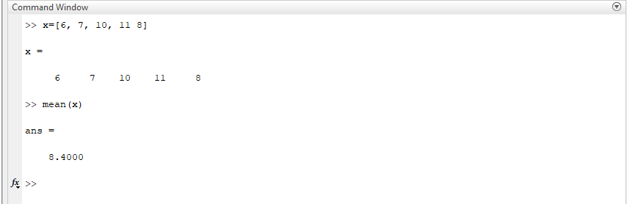
M Amas Waseem

Slide 6
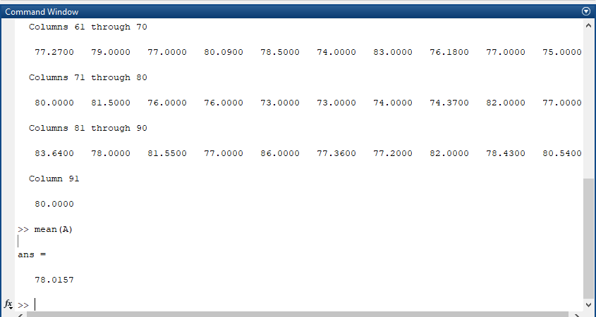
Amas Waseem

Slide 7
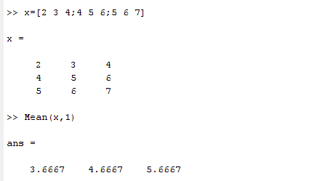
Arithmetic Mean
Mean each column:
Command: Mean (x, 1)

Slide 8
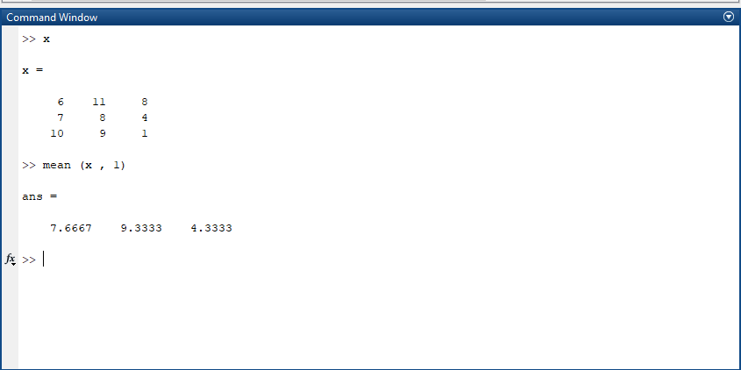
M Amas Waseem

Slide 9
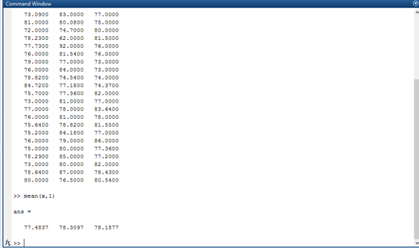
Amas Waseem

Slide 10
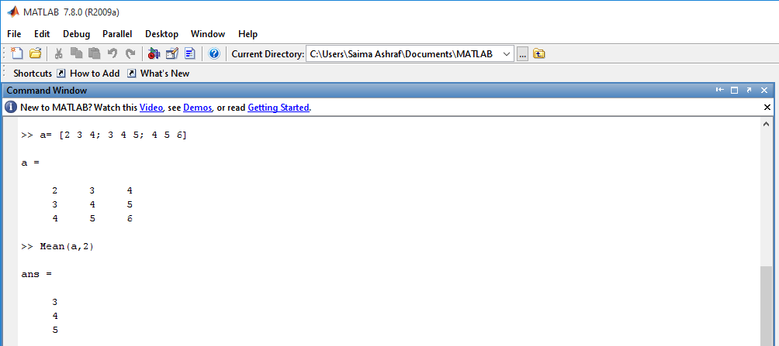
Arithmetic Mean
Mean each row:
Command: Mean (a, 2)

Slide 11
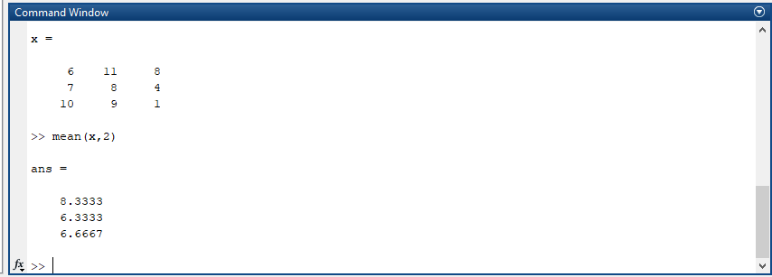
M Amas Waseem

Slide 12
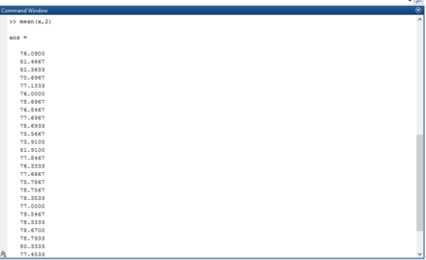
Amas Waseem

Slide 13
Exercise Question
Find the arithmetic mean and median of the following numbers using MATLAB built-in function.
2, 4, 13, 12, 3, 4, 5 ,2 and 8

Slide 14

M Amas Waseem

Slide 15
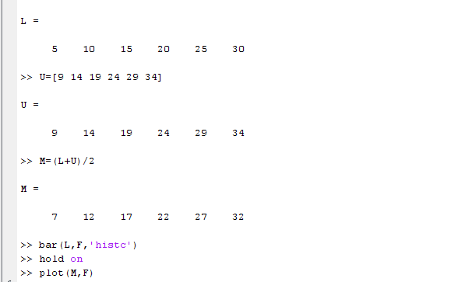
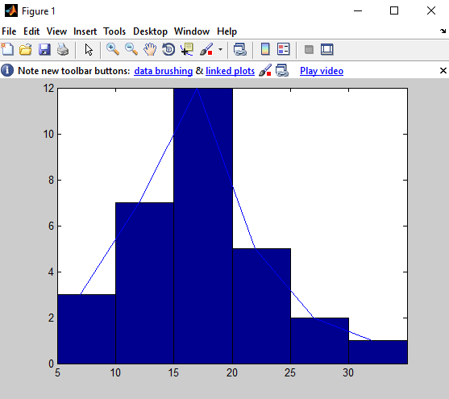
Draw a histogram and frequency polygon on same graph

Slide 16
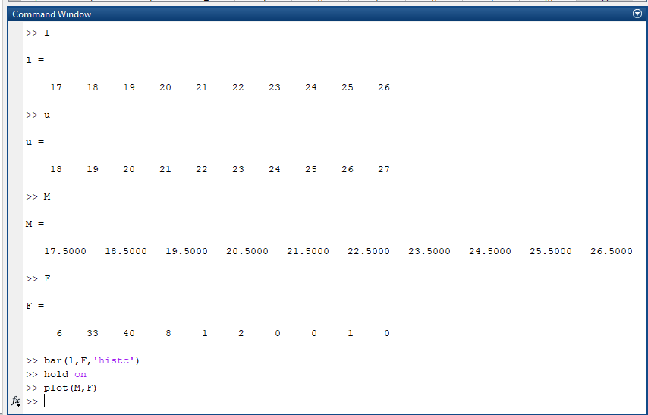
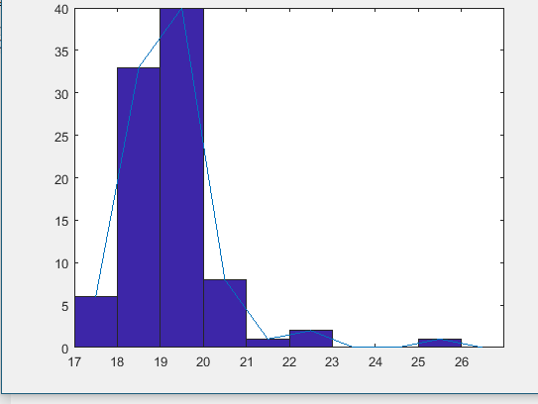
M Amas Waseem

Slide 17
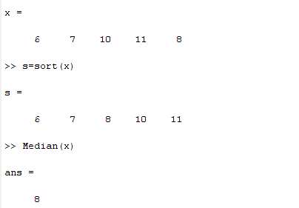
Median
Median:
Command: Median (x)

Slide 18
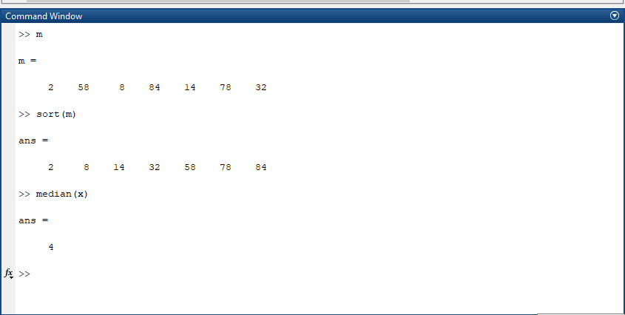
M Amas Waseem

Slide 19
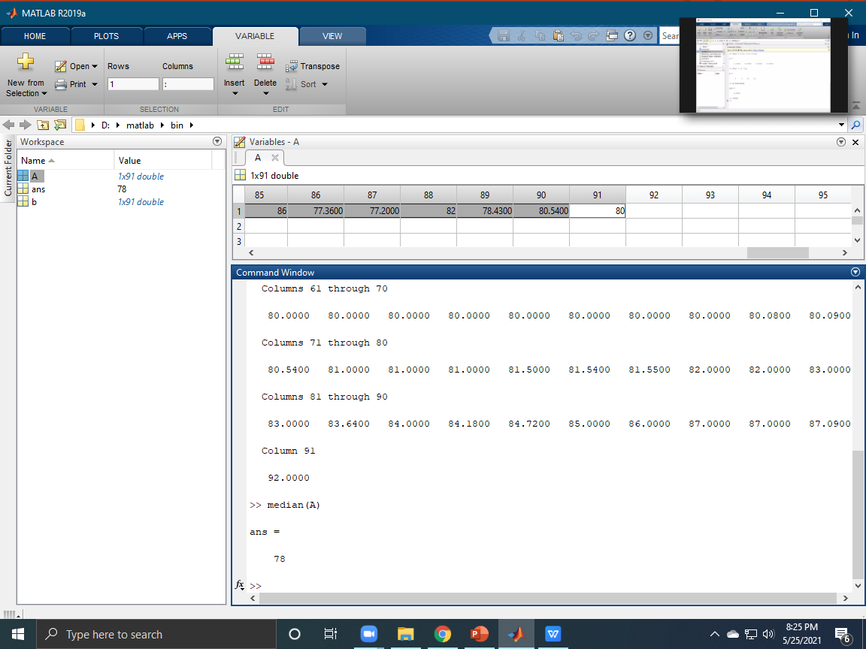
Amas Waseem

Slide 20
Median
Example: 2 (even number of score)
Suppose we have the data below(10 scores)
65 ,55,89, 56, 35 ,14 ,56, 55, 87, 45
we ﬁrst need to rearrange that data into order of magnitude (smallest ﬁrst)
Only now we have to take the 5th and 6th score in our data set and average them to get a
Median of 55.5

Slide 21
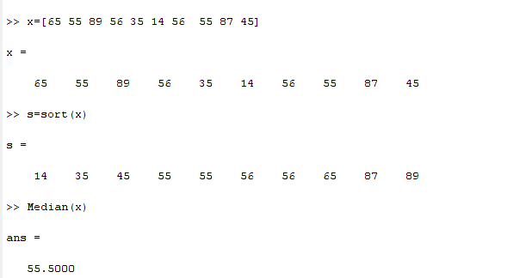
Median

Slide 22
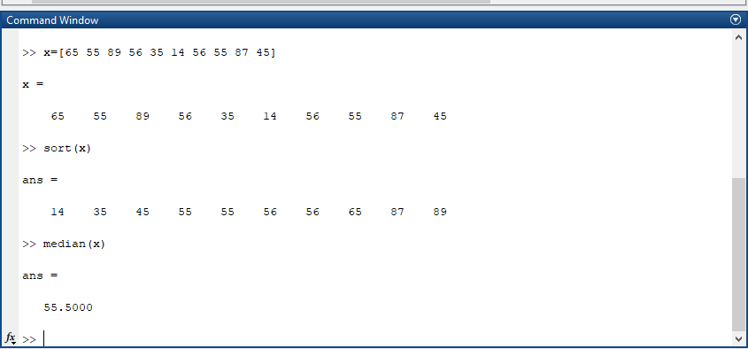
M Amas Waseem

Slide 23
Mode
Example 3:
For the data given below, find Mode
12, 13 14,11,15,16,11,9,56,44,11

Slide 24
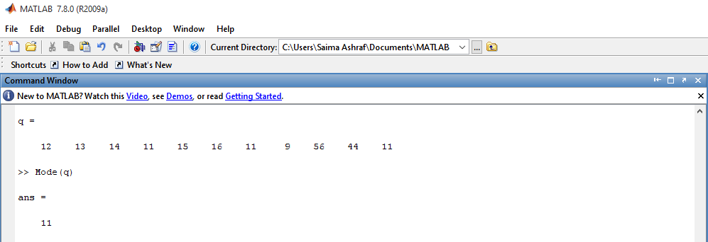
Mode
Command: Mode (q)

Slide 25
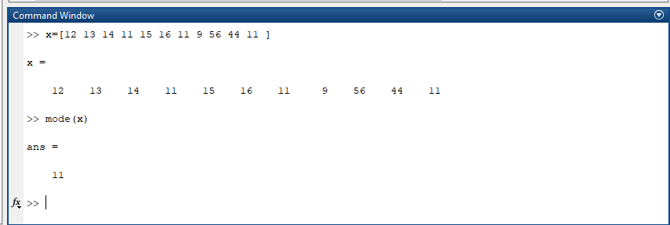
M Amas Waseem

Slide 26
Amas Waseem

Slide 27
Exercise Question
Find the Mode of the following numbers using MATLAB built-in function.
2, 4, 13, 12,12,13, 4,12, 5 ,2 and 8

Slide 28
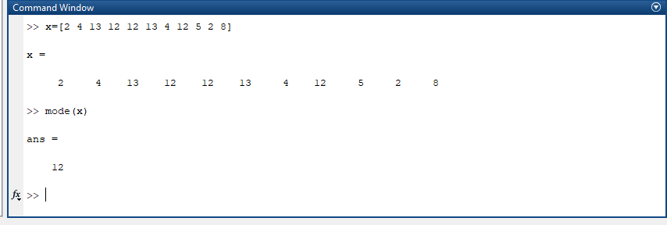
M Amas Waseem

Slide 29
Weighted Mean
Example 4:
Compute the weighted mean of the price of wheat for the following data assuming the quantities consumed as weight.
Price | 5.50 | 6.00 | 7.00 | 8.00
Qty.Consumed(kg) | 4 | 6 | 18 | 10

Slide 30
Step’s
>> x=[5.50 6.00 7.00 8.00]
>> w=[4 6 18 10]
>> sum_w=sum(w)
>> wx= w.*x
>> sum_wx=sum(wx)
>> mean=sum_wx/sum_w

Slide 31
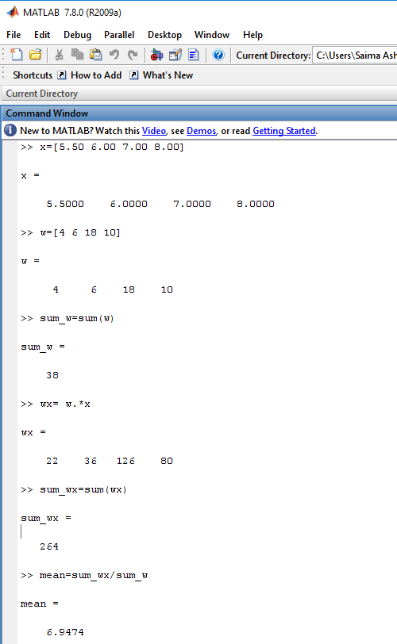
Weighted Mean

Slide 32
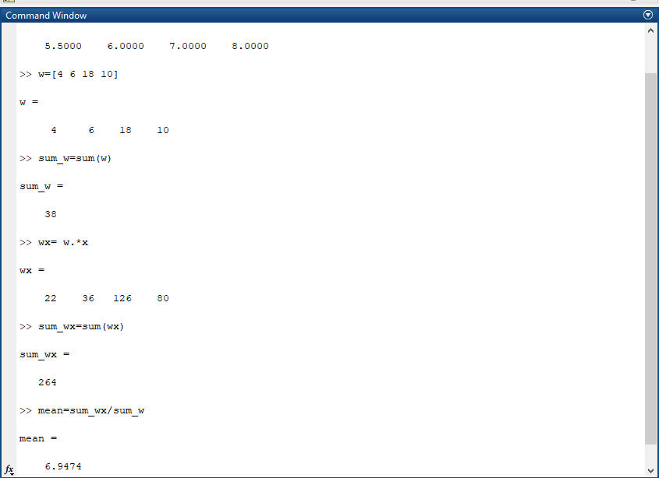
M Amas Waseem

Slide 33
Assignment Question: NOTE: Work in MATLAB
Question: 1
Find the Arithmetic mean of the numbers 3, 56 ,12,32,34,23,1,2,5,7,34,56,23,13,45,56,34,67,56,78.

Slide 34
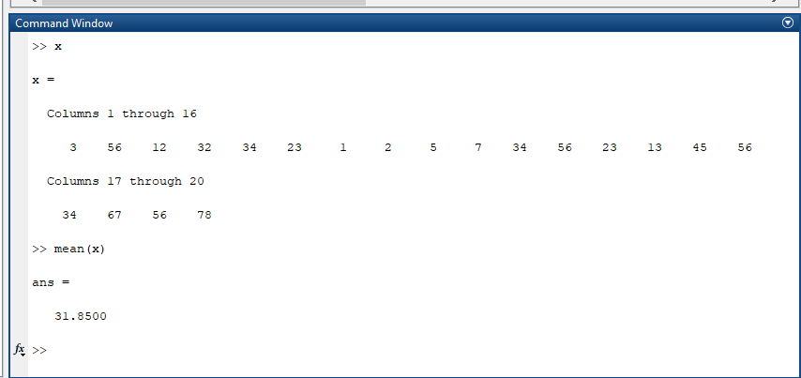
M Amas Waseem

Slide 35
Assignment Question(J)
Question: 3
A person walks 9 hours at a speed of 3 km.p.h,again walks 8 hours at a speed of 4 km.p.h.Find the average speed.
Formula:
Average speed= Total speed/Total Time.

Slide 36
Assignment Question(J):
Question: 4
The following data shows the results of a survey which was conducted to find out the colour preference of people regarding the cars.
Orange Orange White Grey Black Orange White Orange White Grey Black Orange Orange Grey Orange Black Orange White Black Black
Find the Modal colour for the above qualitative data.

